Slide 1
ESP32 Forth Computer
Make a computer with a esp32 similar to Spectrum or JupiterAce but with r3
The interface with screen and keyboard is made with the fabgl library, generate vga signal and get data from a ps/2 keyboard
Sound and mouse are supported but not developer now

Slide 2
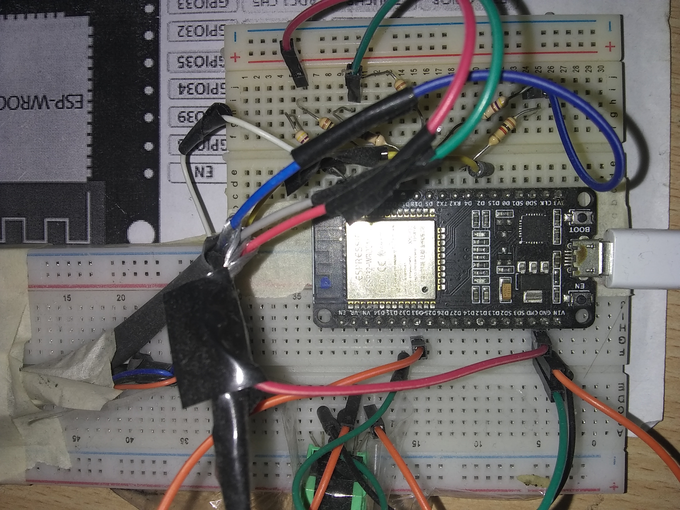

Slide 3
Implementation
Bytecode interpreter with machine forth like vm
Machine forth: CALL, JMP, JZ, LIT
Main loop, big jump table
Very fast interpreter, IP, TOS, *NOS, *RTOS and W in registers
2 registers for traverse memory

Slide 4
Compiler
Transform string in bytecodes and data
Separated from VM
Prefix guide the behavior of compiler
  Define: #data 22 :code dup ;
  Address: 1 ‘data ! ‘code ex |exec
  Comment | this is comment until end of line
  Includes ^source code include.r3
  String “string until next””” | “” = “ in string
  Base $deadbeff %011101 23 12.3

Slide 5
About r3 language
Remove compiler manipulation from code
  Classic forth: IMMEDIATE HERE , CREATE DOES>, etc
  Colorforth: HERE , CYAN WORDS (inline)
  R3: None
Use prefix instead of color (really colorforth have prefix in the codification)
Rethink control flow

Slide 6
programmer not need to think in how work the compile and enable static code analysis
  enable deep optimization when compile
  dead code elimination
  automatic inlines
  discover constant in variables
  reorder code
Separate memory in DATA and CODE
  DICC is discarded when finish compile
  better performance because cache separation (when exist)
  the executable memory (or bytecodes) can be readonly

Slide 7
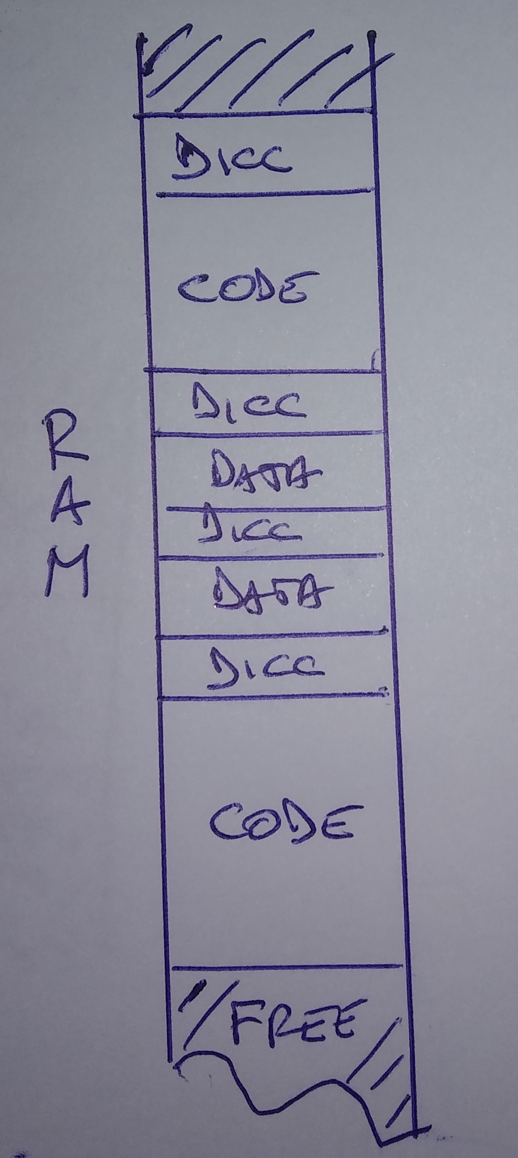
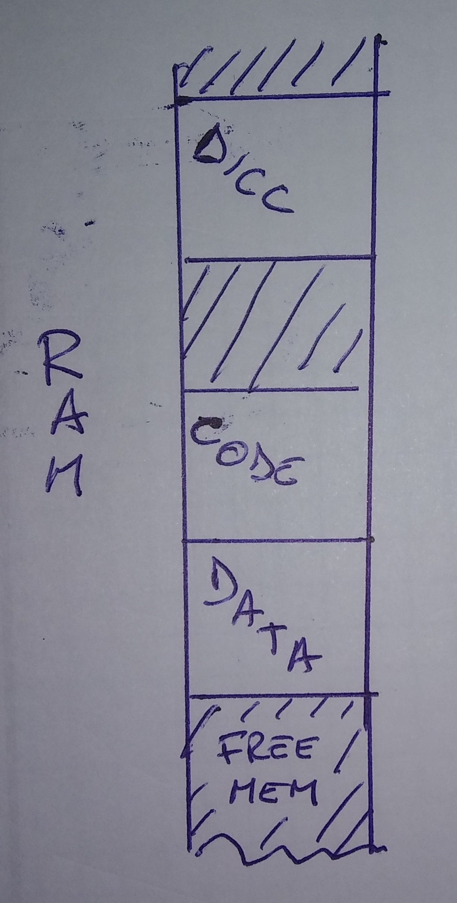
Memory Organization
Classic
Forth
R3

Slide 8
NULL terminate string
file instead blocks
Not use floating point numbers.
Only a Framebuffer, no console, in esp32 use a console experiment
Rigid interface with OS, easy convert to other OS but less flexible, no library can be attached in rt, need to be integrated in words and compile the vm again (similar to eforth in esp32)

Slide 9
Esp32 experiment
Try to do interactive mode, Is not for me (or for my lang)
Make a LOAD-EDIT-RUN cycle
Editor made in r3, not in C!
Better perhaps make only a VM and put the compiler in r3 too (not for now)

